Slide 1
Convection equation and Implementation of Reynolds number
By Adhish Guli Virupaksha

Slide 2
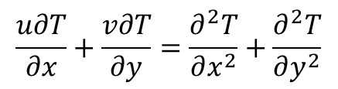
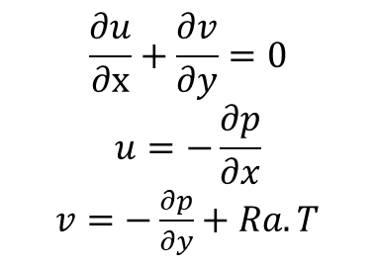
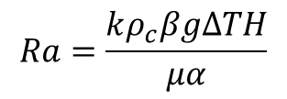
Governing equations for natural convection
It is governed by Darcy's law expressing linear momentum conservation[1]:
$$\frac{∂u}{∂x}+\frac{∂v}{∂y}=0$$
$$u=−\frac{∂p}{∂x}$$
$v=−\frac{∂p}{∂y}+Ra.T$
$$\frac{u∂T}{∂x}+\frac{v∂T}{∂y}=\frac{∂^{2}T}{∂x^{2}}+\frac{∂^{2}T}{∂y^{2}}$$
Where u and v are vertical and horizontal components of dimensionless velocity, x and y are space coordinates, p and T are dimensionless fluid pressure and temperature and Ra is Rayleigh number represented by:
where k is the permeability, ρ_{c} is the fluid density at reference temperature, β is the fluid thermal expansion, g is the gravity, T is the temperature gradient between the hot and cold walls , H is the square size, μ is the fluid viscosity and α is the medium equivalent thermal diffusivity.
$$Ra=\frac{kρ_{c}βgΔTH}{μα}$$

Slide 3
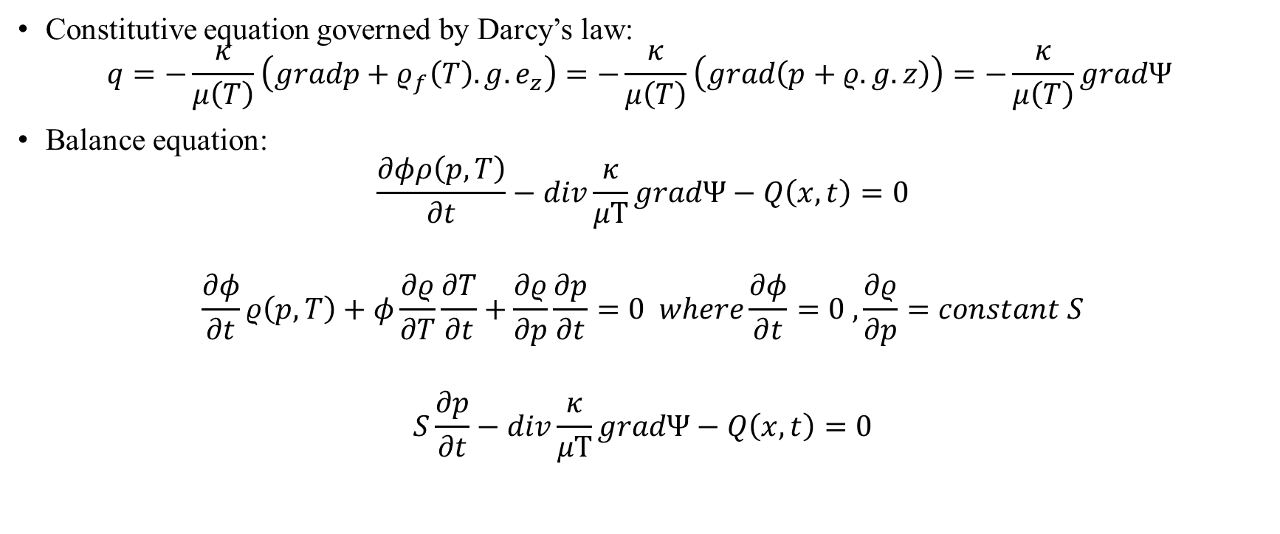
Groundwater flow
Constitutive equation governed by Darcy’s law:
$$q=−\frac{κ}{μ\left(T\right)}\left(gradp+ρ_{f}\left(T\right).g.e_{z}\right)=−\frac{κ}{μ\left(T\right)}\left(grad\left(p+ρ.g.z\right)\right)=−\frac{κ}{μ\left(T\right)}gradΨ$$
Balance equation:
$$\frac{∂φρ\left(p,T\right)}{∂t}−div\frac{κ}{μT}gradΨ−Q\left(x,t\right)=0$$
$$\frac{∂φ}{∂t}ρ\left(p,T\right)+φ\frac{∂ρ}{∂T}\frac{∂T}{∂t}+\frac{∂ρ}{∂p}\frac{∂p}{∂t}=0 where\frac{∂φ}{∂t}=0 ,\frac{∂ρ}{∂p}=constant S$$
$$S\frac{∂p}{∂t}−div\frac{κ}{μT}gradΨ−Q\left(x,t\right)=0$$

Slide 4
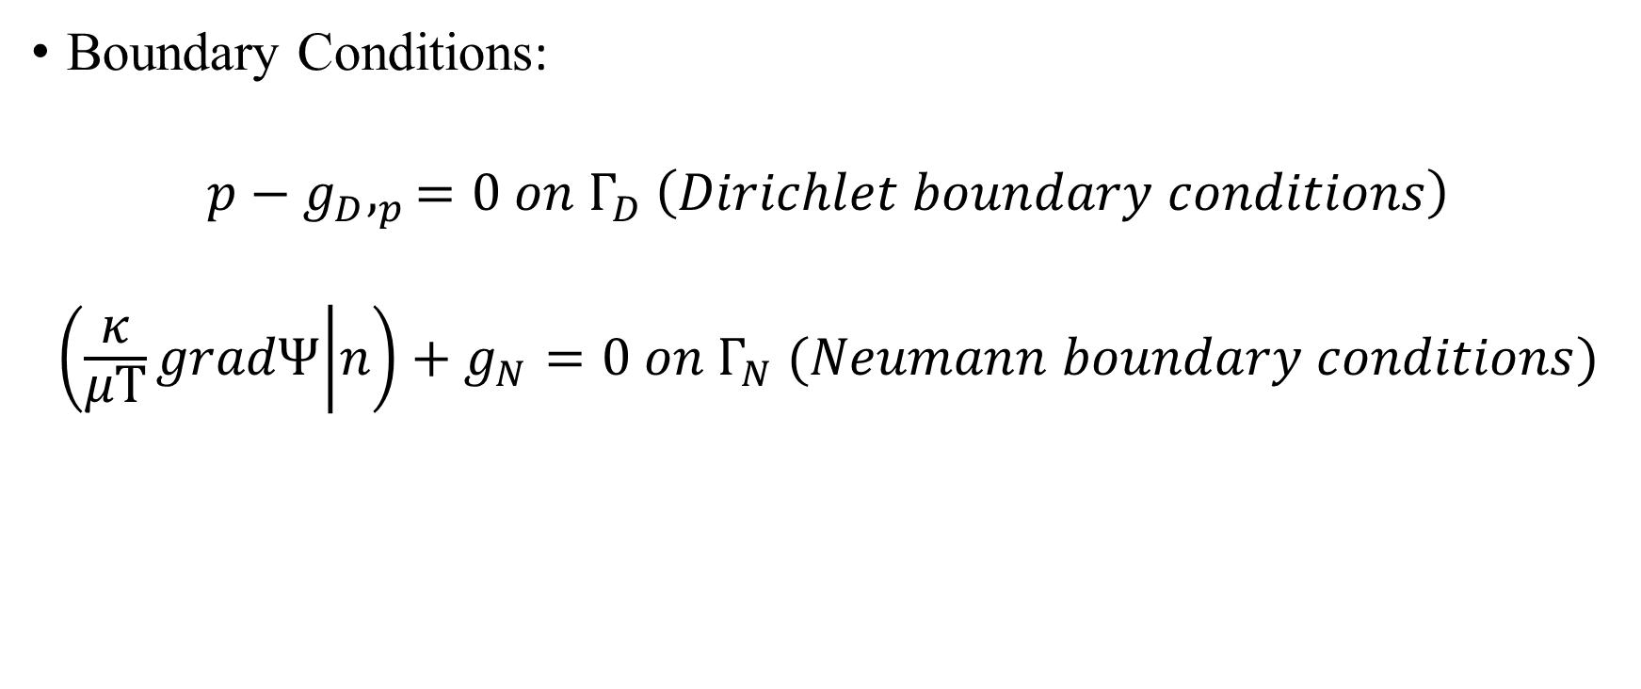
Boundary conditions
Boundary Conditions:
$$p−g_{D},_{p}=0 on Γ_{D} \left(Dirichlet boundary conditions\right)$$
$$\left(\frac{κ}{μT}gradΨ | n\right)+g_{N}=0 on Γ_{N} (Neumann boundary conditions)$$

Slide 5
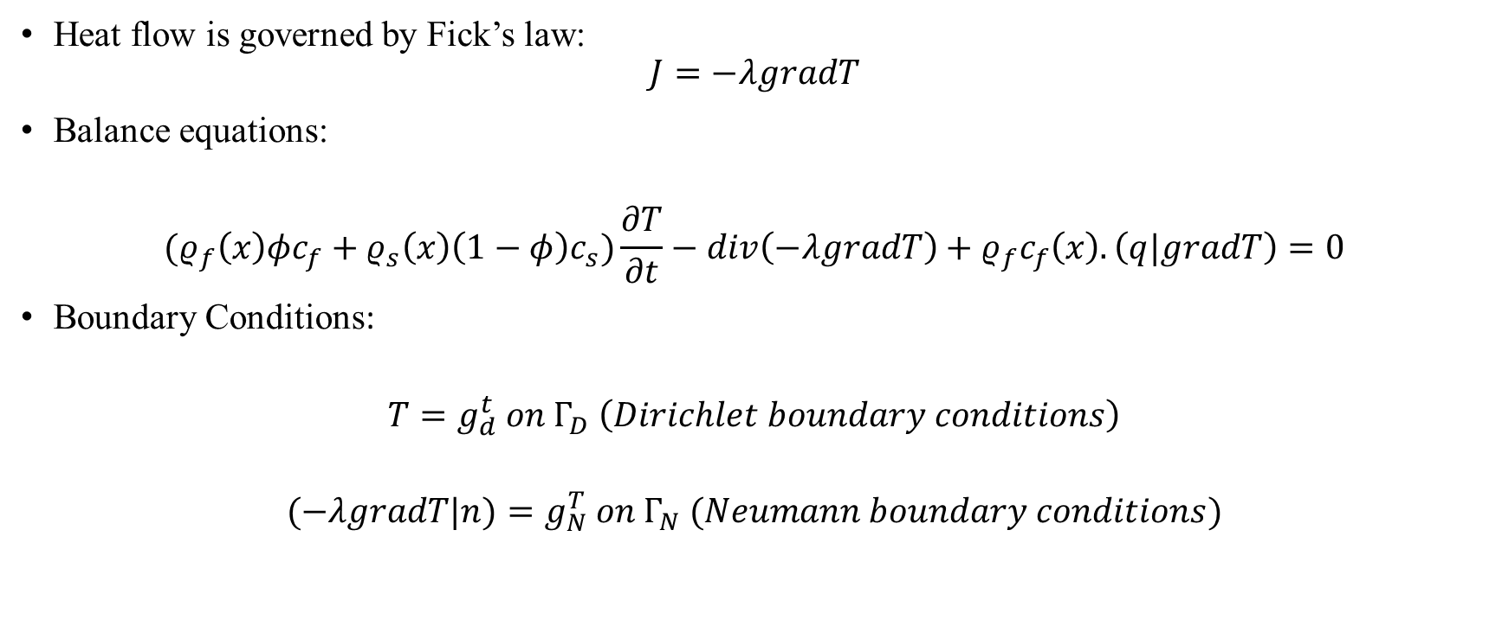
Heat conduction
Heat flow is governed by Fick’s law:
$$J=−λgradT$$
Balance equations:
$${(ρ}_{f}\left(x\right)φc_{f}+ρ_{s}\left(x\right)\left(1−φ\right)c_{s})\frac{∂T}{∂t}−div\left(−λgradT\right)+ρ_{f}c_{f}\left(x\right).\left(q|gradT\right)=0$$
Boundary Conditions:
$$T=g_{d}^{t} on Γ_{D} \left(Dirichlet boundary conditions\right)$$
$$(−λgradT|n)=g_{N}^{T} on Γ_{N} (Neumann boundary conditions)$$

Slide 6
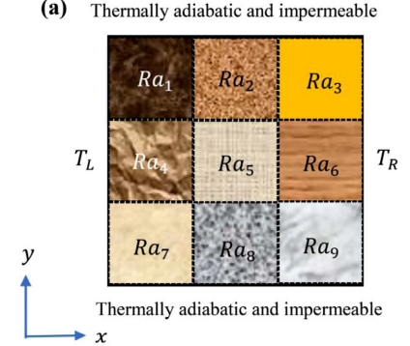
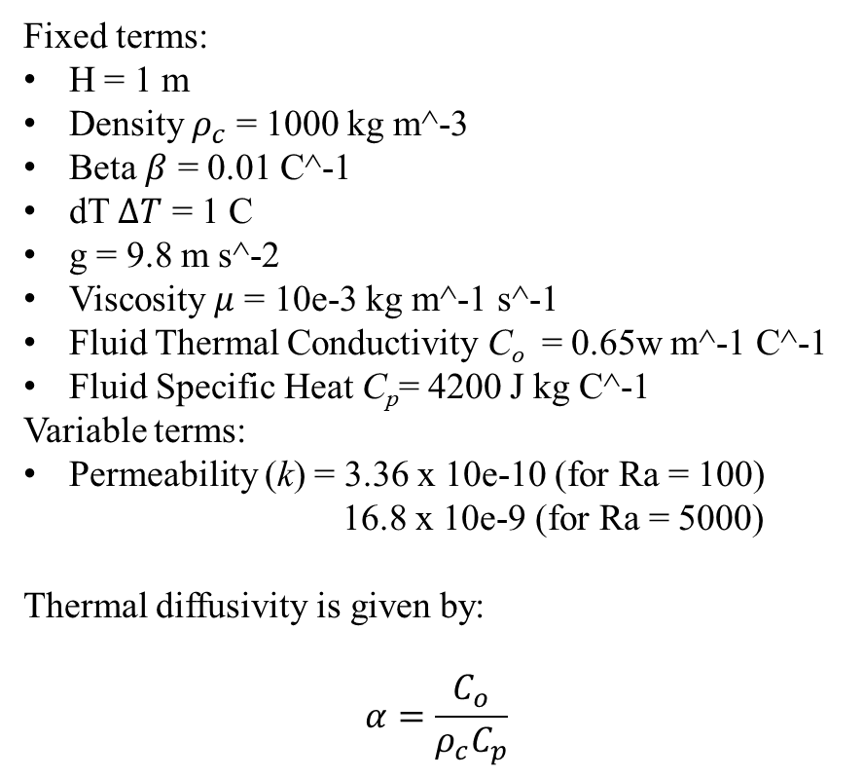
Required Implementation
Proposed Implementation[2]
Fixed terms:
H = 1 m
Density $ρ_{c}$ = 1000 kg m^-3
Beta $β$ = 0.01 C^-1
dT $ΔT$ = 1 C
g = 9.8 m s^-2
Viscosity $μ$ = 10e-3 kg m^-1 s^-1
Fluid Thermal Conductivity C_{o} = 0.65w m^-1 C^-1
Fluid Specific Heat C_{p}= 4200 J kg C^-1
Variable terms:
Permeability (k) = 3.36 x 10e-10 (for Ra = 100)
16.8 x 10e-9 (for Ra = 5000)
Thermal diffusivity is given by:
$$α=\frac{C_{o}}{{ρ_{c}C}_{p}}$$
Fig 1. Implementation of Ra values[1]

Slide 7
Steps in proposed implementation
Generate 2D input mesh using generateStructuredMesh tool from Opengeosys.
Interpolate permeability to different blocks of input mesh using randomly selected values from the set. A modified version of the script provided by Dr. Dominik Kern is utilized for this purpose.
Generate ‘n’ samples along with the values assigned to these samples stored in csv file.
Sample ‘k’ values vary such that final Ra values of these samples vary between 100 to 5000.

Slide 8
Reference
[1]Fajraoui, N.; Fahs, M.; Younes, A. & Sudret, B. Analyzing natural convection in porous enclosure with polynomial chaos expansions: Effect of thermal dispersion, anisotropic permeability and heterogeneity. International Journal of Heat and Mass Transfer, 2017, 115, 205-224
[2]Fahs, Marwan & Graf, Thomas & Tran, Tuong Vi & Ataie-Ashtiani, Behzad & Simmons, Craig & Younes, Anis. (2020). Study of the Effect of Thermal Dispersion on Internal Natural Convection in Porous Media Using Fourier Series. Transport in Porous Media. 131. 10.1007/s11242-019-01356-1.

